Slide 1
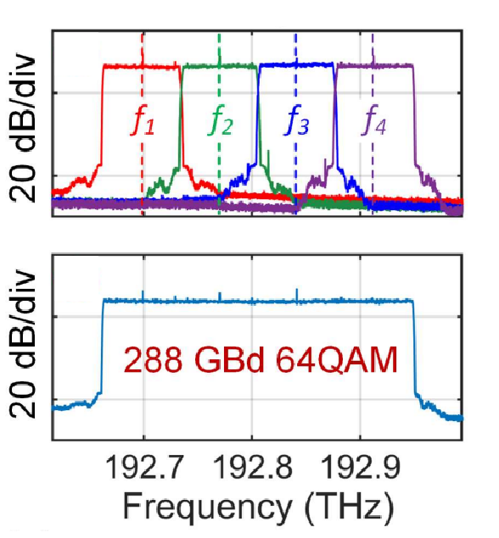
Bachelor / Master Thesis:
Packaged signal-combining element for optical arbitrary waveform generation (OAWG)
To keep up with the ever-growing need for faster systems, higher bandwidth signals are needed. This is, however, limited by the bandwidth of digital-to-analog converters (DACs). Different techniques are investigated to surpass such limits, among which is the OAWG system. It is based on synthesizing broadband waveforms in the optical domain by multiplexing different signal tributaries. For such technique to work, coherent signal combination is needed to preserve the phase relations between slices. The work will include investigation, characterization, verification and packaging of such signal-combining techniques using different photonic integrated circuits (PICs). Another task would be integrating such systems into compact solutions using either micro-controllers units (MCUs) or field programmable gate arrays (FPGAs).
Your tasks:
Characterization of PIC designs
Design of existing and new PIC
Experimental characterization and verification
Investigation of compact implementations (MCU/FPGA)
Top: Sliced spectra of tributaries generated by different IQ modulators. Bottom: Coherently combined tributaries.
Source: D. Fang et al., "Optical arbitrary waveform generation (OAWG) based on RF injection-locked Kerr soliton combs,“ (ECOC 2023), Hybrid Conference, Glasgow, UK, 2023, pp. 1047-1050, doi: 10.1049/icp.2023.2431.
For detailed information contact:
Prof. Dr. Christian Koos
Christian.koos@kit.edu
Tel. 0721-608-42481
M. Sc. Mohamed Kelany
Mohamed.kelany@kit.edu
Tel. 0721-608-41935

