Slide 1
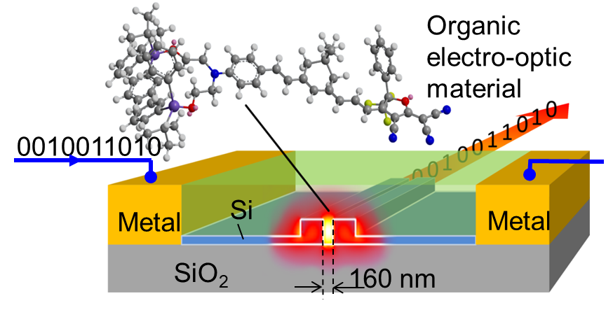
Bachelor / Master Thesis: Process development for high performance silicon-organic electro optic devices
The large amount of data demands mega-data centers with high bandwidth and energy efficient optical interconnects. Utilizing a low footprint, high transfer rates and highly energy-efficient operation, silicon-organic hybrid (SOH) photonic devices have become a suitable candidate, to play a key role in the future of datacom. In those devices, the lacking second-order nonlinearity of silicon is compensated by integrating high performance electro optic organic materials. Electro optic molecules usually exhibit a high Pockels-effect, with values of r₃₃ way above 100 pm/V.
This thesis is focused on the integration and characterization of electro optic molecules into the silicon photonic platform. You will develop new characterization methods that gain insights to improve the device performance.
Your tasks:
Development of novel fabrication methods for SOH modulators
Establish a new characterization method for these devices
Building a theoretical model and verifying it
Device fabrication & characterization
For detailed information contact:
Dr. Carsten Eschenbaum
Carsten.eschenbaum@kit.edu
Tel. 0721-608-47170
Prof. Dr. Christian Koos
Christian.koos@kit.edu
Tel. 0721-608-42481
Function scheme of a Silicon-organic hybrid phase shifter

